Slide 1
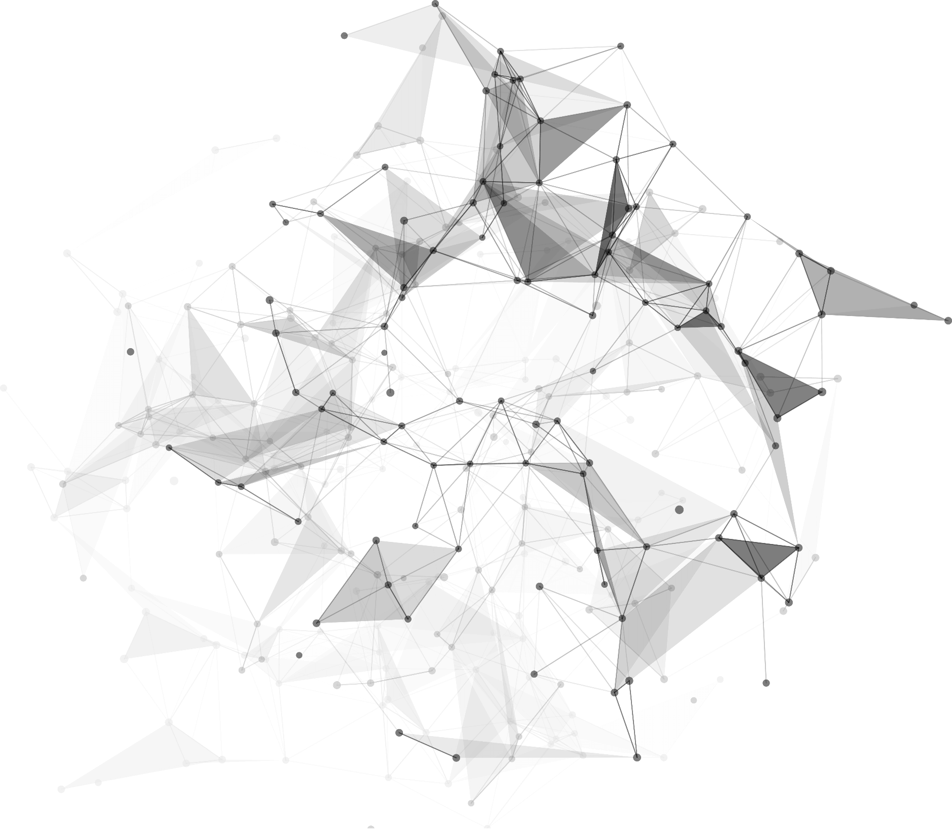
2
0
2
2
HarmonyOS Cross-Device Distributed File System
Reporter: 古薇 1930026036
陈玙涛 1930026016
薛劭杰 1930026143

Slide 2
https://www.ypppt.com/
1
Part 01
Introduction of HarmonyOS

Slide 3

01
HarmonyOS
An innovative, distributed operating system for the Internet of Everything (IoE) era

Slide 4
01
Why
Where
Dongguan
When
August 9, 2019; 2 years ago
Created by
Huawei Technologies Co., Ltd.

Slide 5
01
Reasons
To prevent the US from prohibiting Huawei from using Android on future smartphone products
To collaborate and interconnect with multiple smart devices.
To make full use of Huawei’s strength in the equipment for Fifth-generation (5G) wireless communication

Slide 6
01
Smart Home Devices
Who
The number of HarmonyOS devices has exceeded 150 million - October 22, 2021
Tablets
Smartphones
IoT Devices

Slide 7
c
01
1
Hardware collaboration and resource sharing
The devices running HarmonyOS are aggregated at the system layer to form a super device, allowing flexible scaling of device hardware capabilities.
New Features

Slide 8
c
01
2
One-time development for multi-device deployment
HarmonyOS allows you to develop your application once, and then deploy it across a broad range of devices.
New Features

Slide 9
c
01
3
Unified OS for flexible deployment
HarmonyOS supports on-demand deployment for devices with different capabilities.
New Features

Slide 10
2
Part
Virtual File System in HarmonyOS

Slide 11
02
Harmony Distributed File System
Function
Access, operation between multiple devices
Sense the storage device where the file is located
Transfer files between multiple devices seamlessly
Notes:
We know that Harmony system can support mutual access, sharing and operation of files between multiple devices. Additionally, the application can sense the storage device where the file is located, and transfer the file between multiple devices fast. These functions are greatly benefited from the services of the Harmony distributed file system.

Slide 12
02
VFS in Harmony OS
Virtual File System
Provide with a unified Unix-like file operation interface
Do not need to care about the type of underlying file system
Different file systems on different devices appear identical
to the HarmonyOS core
Notes:
Virtual File System is the virtual layer of the file system, it provide users with a unified Unix-like file operation interface. By adding a VFS layer to the system to provide a unified interface, the differences between the underlying file systems are shielded,
so that the system calls that access the file system do not need to care about the underlying file system type. In this way, different file systems on different devices appear identical to the Harmony system core and other processes running in the system.

Slide 13

02
Basic Flow
Mapping file system types and interfaces for file system operations by three types of interfaces
Access the Linux VFS using system calls from the VFS user interface
01
03
04
02
Distribute the unified calls to the different file systems for the underlying operations
Use the local file system call to make some requests such as read and write.
Notes:
Firstly, User processes access the Unix VFS using system calls from the interface. Then the layer distributes the unified calls to the different file systems for the underlying operations in the form of function pointers for the different file system types. The implementations of each file system include interfaces for mount related operations, mapping file system types and for file system operations. Take windows OS as an example, we use the VFS system call to get the NTFS file system mapped to Windows, and then use the Windows file system call to make some requests such to the Windows file system.

Slide 14






02
VFS Application
F2FS /
EROFS
HDFS
HMDFS
Notes:
For mobile devices that support HarmonyOS, the file systems include f2 file system, ERO file system in new mobile phones and tablet. VFS plays an critical role to access different file systems easily between PC, mobile and even other storage devices. Then it also need the HMDFS (harmony distributed files system) as intermediate of different file system to perform distributed operation permission control.

Slide 15
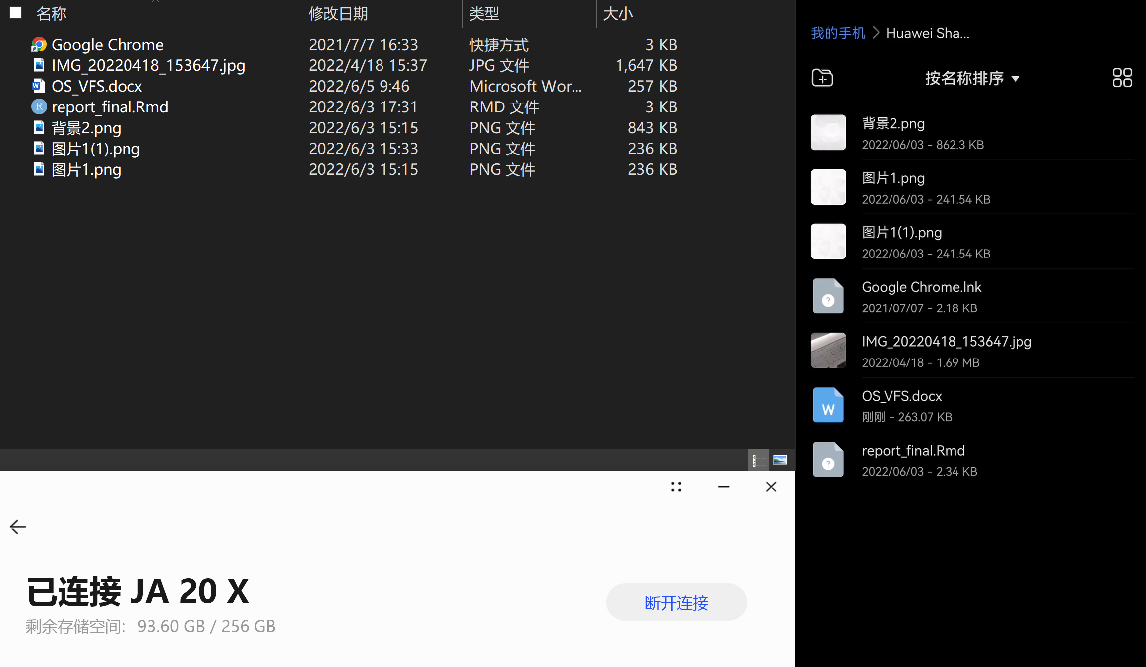
Notes:
Here is experiment of the mobile phone and windows file system connection.

Slide 16
3
Part 3
Harmony distributed file service
Notes:
Now, let me introduce some main concepts of Harmony distributed file service.

Slide 17
03
After two or more devices establish a secure connection and build a virtual file system, the harmony distributed file service can help users obtain files between multiple devices seamlessly.
Notes:
After two or more devices establish a secure connection and build a virtual file system, the harmony distributed file service can help users obtain files between multiple devices seamlessly.

Slide 18
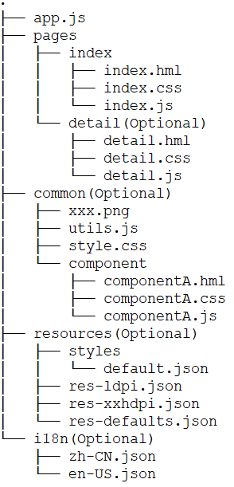
03
Ability
Ability is an abstraction of an application's capabilities and is an important part of the application.
Feature Ability and Particle Ability
JS FA
JS FA refers to applications based on JavaScript or JavaScript and Java hybrid development FA.
Notes:
Users and applications view files as some kind of structure with organized records, such as a sequential structure. And in Harmony OS, Ability is an abstraction of an application's capabilities and is an important part of the application. There are 2 kinds of ability, Feature Ability and Particle Ability. A typical development directory structure for JS modules for JS FA applications is shown on the left.

Slide 19

03
devices establish a pairing relationship through accounts
verifying the trust relationship
establish a secure connection channel
transmit data securely according to the rules of data flow
PC
Pad
Phone
Refrigerator
Notes:
In order to ensure the secure flow of data between virtual super terminals, it is required that each device is correctly trusted and has established a trust relationship, which means that multiple devices establish a pairing relationship through Huawei accounts and can establish a secure connection channel after verifying the trust relationship, and transmit data securely according to the rules of data flow.

Slide 20
03
Harmony OS is a distributed operating system for full scenarios with a component-based design that requires system components to be run on devices with different configurations.
Mini System
Small System
Standard System
MCU-like processors
minimum memory of 128 KiB
wearable smart devices, sensor devices, ...
oriented application processors
minimum memory of 1 MiB
electronic cat eyes, routers, ...
application processors
minimum memory of 128 MiB
high-end refrigerator displays, ...
Notes:
HarmonyOS is a distributed operating system for full scenarios with a component-based design that requires system components to be run on devices with different configurations. And there are 3 kinds of system, Mini System, Small System and Standard system.

Slide 21
03
MUSL (read/write/open/close, etc)
System call (Sysread/Syswrite/Sysopen, etc)
VFS
VFS
PageCache
Managing the root directory tree
JFFS2 | Yaffs | FAT | ROMFS | NFS
BCache
PageCache & BCache
Flash
Improve file system read and write performance
Principle of File System
Notes:
The figure on left shows the principle of file system.

Slide 22
03
Harmony OS introduces the Little file system, which is a small Flash file system(JFFS2)
LittleFS combines the ideas of log-structured and COW (copy-on-write) file system
Storing file metadata in a log structure and data in a COW structure
Notes:
Harmony OS introduces the Little file system, which is a small Flash file system that combines the ideas of log-structured and COW (copy-on-write) file system, storing file metadata in a log structure and data in a COW structure.

Slide 23
03
file name
file size
creation/ access/ modification time
...
metadata
Log structure
45784￥
a resource management technique
implement fork system calls that share the virtual memory (pages) of the OS
space efficient
...
COW
COW structure
Notes:
As we know, file metadata is the data used to characterize files, containing information such as file name, size, creation, access, modification time, etc. COW is a resource management technique that can be used to implement fork system calls that share the virtual memory (pages) of the operating system. One of the reasons Harmony OS introduced COW is that it is so space efficient that its reserved snapshot storage space only needs to be large enough to capture the changed data.

Slide 24
03
Little FS has powerful power-loss resilience
Little FS uses a dynamic loss equalization algorithm called statistical loss equalization
Little FS is a good choice when looking for a Flash file system with power-down recovery and support for wear-leveling on a small device with very tight resources
Notes:
This special storage method gives LittleFS a powerful power-loss resilience designed to handle random power failures. Also, LittleFS uses a dynamic loss equalization algorithm called statistical loss equalization .
In summary, LittleFS is a good choice when looking for a Flash file system with power-down recovery and support for wear-leveling on a small device with very tight resources.

Slide 25
Reference
[1]“About HarmonyOS-HarmonyOS Overview-Introduction-HarmonyOSDeveloper.” HarmonyOS Developer, https://developer.harmonyos.com/en/docs/documentation/doc-guides/harmonyos-overview-0000000000011903. Accessed 5 June 2022.
[2]“HarmonyOS.” Wikipedia, https://en.wikipedia.org/wiki/HarmonyOS. Accessed 5 June 2022.
[3]“HarmonyOS 2 - Huawei Global.” HUAWEI Consumer, https://consumer.huawei.com/en/harmonyos/.
Accessed 5 June 2022.
[4]“HarmonyOS 'is a success', embedded to 150 million devices, appliances: Huawei.” Global Times, 23 October 2021, https://www.globaltimes.cn/page/202110/1237087.shtml. Accessed 5 June 2022.
[5] “Harmony light kernel M source code analysis - virtual file system VFS” https://bbs.huaweicloud.com/blogs/326407. Accessed 14 January 2022
[6]Stallings, W. (1998). Operating systems internals and design principles. Prentice-Hall, Inc..
[7]HarmonyOS All rights reserved ©2022. (n.d.). Distributed File Service Overview. docoment center. Retrieved June 6, 2022, from https://developer.harmonyos.com/cn/docs/documentation/doc-guides/database-dfs-overview-0000000000030154

Slide 26
